Slide 1
Digital Portfolio
J. Keerthana
STUDENT NAME:
REGISTER NO AND NMID: 3AB9A015D7F221BBF4948D5466024E06
DEPARTMENT:Bsc computer science
COLLEGE: COLLEGE/ UNIVERSITY R. B Gothi jain college for women
University of madras

Slide 2
PROJECT TITLE
Interactive Digital portfolio Using Front end development

Slide 3


AGENDA
Problem Statement
Project Overview
End Users
Tools and Technologies
Portfolio design and Layout
Features and Functionality
Results and Screenshots
Conclusion
Github Link
3/21/2024 Annual Review

Slide 4

PROBLEM STATEMENT
The problem is that without a digital portfolio, individuals have limited opportunities to present their technical skills, academic background, and project work in a professional and interactive format. This creates a gap between what candidates can do and how effectively they can communicate it to potential employers or institutions.

Slide 5

PROJECT OVERVIEW
The Digital Portfolio Project is a personal website developed using HTML, CSS, and JavaScript to showcase my profile, education, skills, and projects in a professional manner. It acts as an online resume where recruiters, teachers, and peers can easily access my details. The portfolio is designed with sections such as Home, About Me, Education, Skills, Projects, Resume Download, and Contact, ensuring that all essential information is presented clearly.

Slide 6

WHO ARE THE END USERS?
Recruiters / HR managers → who review your profile for internships or jobs. College faculty / evaluators → if it is part of your academic project or assessment. Clients → if you use the portfolio to showcase skills for freelancing or project work. Peers, mentors, and professional connections → who want to know about your background and achievements.

Slide 7

TOOLS AND TECHNIQUES
HTML5 – For structuring the content of the portfolio (headings, sections, forms). 2. CSS3 – For styling, layout, colors, fonts, and responsiveness. 3. JavaScript – To add interactivity, form validation, and dynamic features like auto-updating footer. 4. VS Code – Code editor used for development. 5. Git & GitHub – For version control and hosting (GitHub Pages).

Slide 8
POTFOLIO DESIGN AND LAYOUT
The design and layout of a digital portfolio play a crucial role in creating a strong first impression on viewers. A well-organized layout ensures that the portfolio is easy to navigate, visually appealing, and effectively showcases the creator’s skills and achievements. Key design principles include a clean and consistent structure, balanced use of white space, readable typography, and a cohesive color scheme that aligns with the personal or professional brand
8

Slide 9
FEATURES AND FUNCTIONALITY
Digital Portfolio Features and Functionality: A digital portfolio is most effective when it combines appealing design with practical functionality. Core features often include sections for showcasing projects, work samples, or case studies, along with detailed descriptions, images, and multimedia content like videos or presentations.

Slide 10
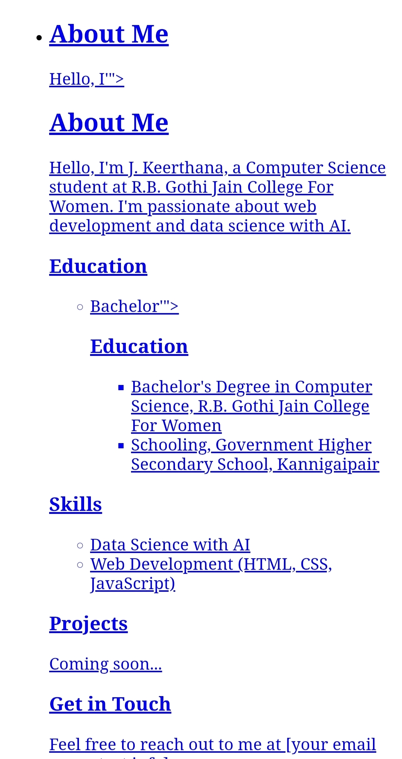

RESULTS AND SCREENSHOTS
3/21/2024 Annual Review
10

Slide 11
CONCLUSION
A conclusion is the final outcome or result of a process, or the logical deduction made after carefully considering all the relevant information or facts. It can refer to the end of a speech or piece of writing, often a summary of main points, or the decision one makes after thinking carefully about a situation.
11

